Slide 1
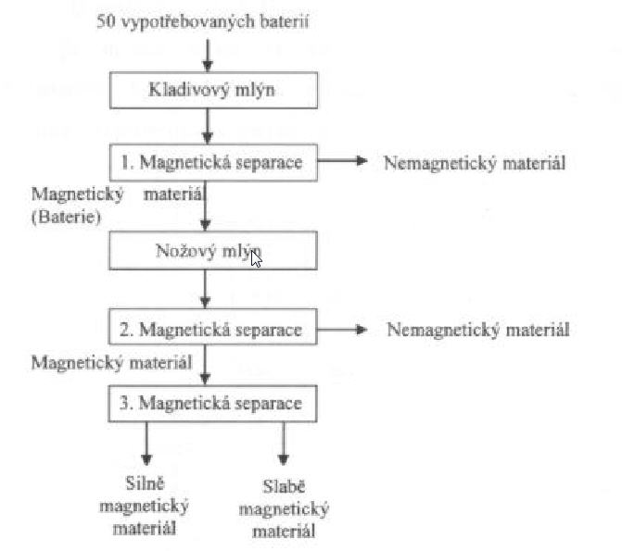

Slide 2
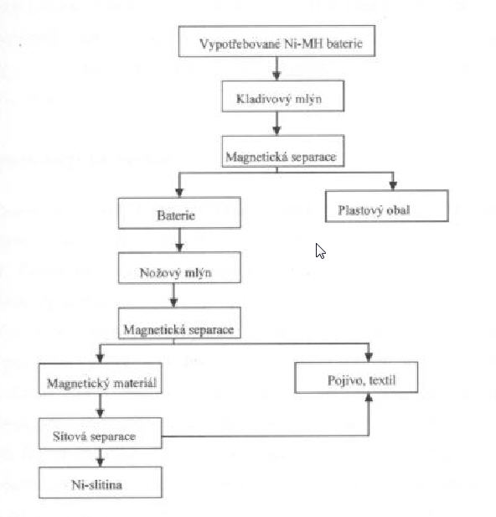

Slide 3
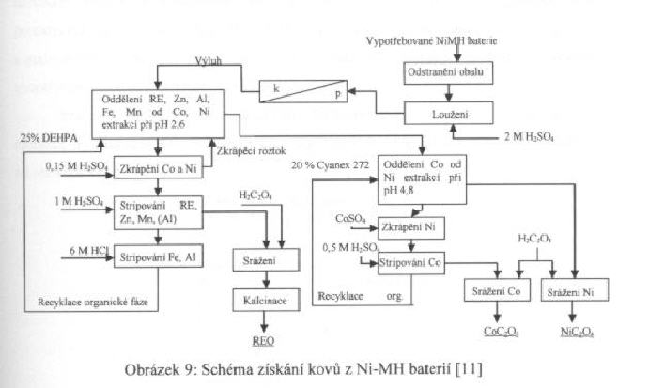

Slide 4
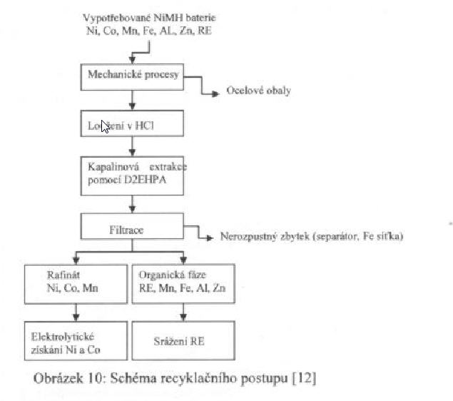

Slide 5
di-(2-ethylhexyl) phosphoric acid (D2EHPA)
di-(2,4,4-trimethyl pentyl) phosphinic acid (Cynex-272)

